Slide 1

Component 03 -Programming Project

Slide 2
Programming Project Overview
Allows candidate flexibility in choice of project
Flexibility of language
  Specified in Specification
  Ask OCR if you want to use something different
Now uses ‘Stakeholders’ rather than requirement for a ‘real’ 3rd party end user
Push to focus on the development and coding sides
Focus on ‘project complexity’
Focus on RAD/Prototyping/Agile development
No need for a User Guide
Similar levels of support by teachers
© OCR 2016

Slide 3
Comparison of Old to New
Similar Features
Changes
Same basic structure
Similar marking areas
Same wide choice of languages
Same levels of teacher support
Similar delivery time anticipated
Will still interact with 3rd Parties
Programming Techniques
Graphical User Interface highly likely
User Guide removed
Level ICT in terms of complexity
Updated mark scheme/banding
Could start in Year 12
Requirement for a ‘real end user’ removed to focus on Stakeholders
Assessment of complexity is key
Focus on Agile design
© OCR 2016

Slide 4
Where do I start?
Prior Specification Sample Material
  The H447 Sample Projects
  Still strong ideas for current specification
  Have a lot of good practice in
  Would likely still do well within current assessment criteria
Project Complexity Guide
  Supports knowledge of ‘complexity’
  Provides other sample ideas of projects
© OCR 2016

Slide 5
Where do I start?
Read the mark scheme!
  Note the changes in the requirements
  Note changes in headings/sections
  Be familiar with the expectations
  Apply this to projects
Discuss the mark scheme with learners to help them understand their targets
© OCR 2016

Slide 6
Preparation of Students
Ensure they are familiar with the Process for Success
Ensure they have learnt and understood all programming techniques/programming theory from Spec
Ensure they are familiar with how they will be marked/assessed
Ensure they pick a project they will engage with and be motivated to complete!
© OCR 2016

Slide 7
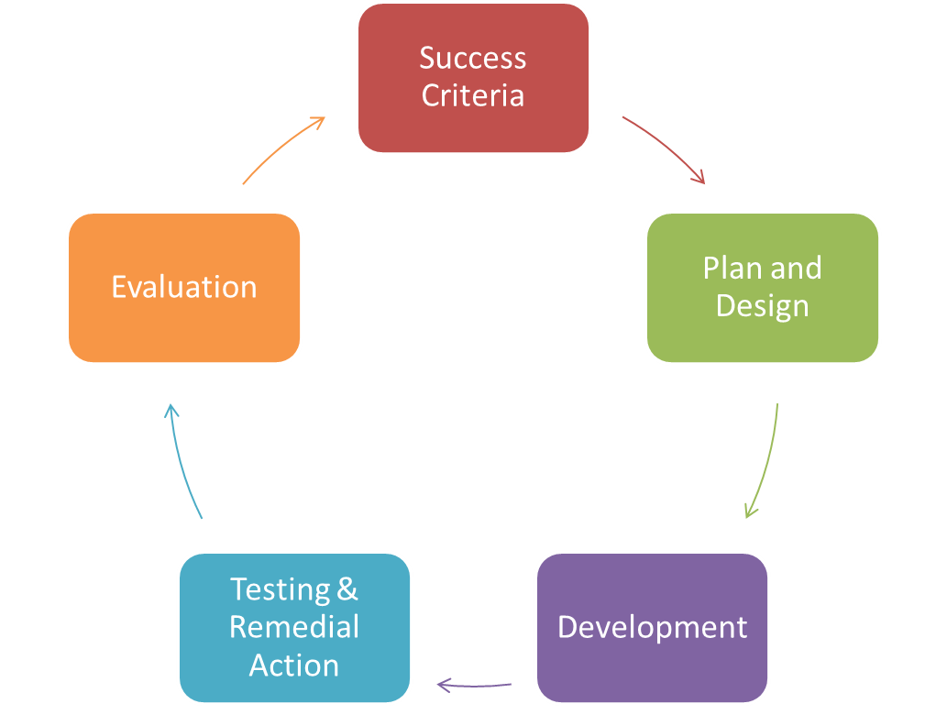
Iterative Development Process
Success criteria
- What will a successful solution do
Planning and design
- Pseudocode, flowcharts, DFDs, Class Definitions/UML etc
Development
- Narrative of steps taken
- Annotated Code
- Discussion of methodology
Testing and remedial actions
- narrative of changes made
Evaluation
- link to success criteria
- evidence of success or not
© OCR 2016

Slide 8
What languages can I use?
Listed in the Specification
We have also allowed use of:
  Swift
  JSON
  NodeJS
  Unreal/Unity Engines (linked to C# etc)
  LUA
  Robot X / Monkey X
  JavaScript – expected to be used in conjunction with other things
© OCR 2016

Slide 9
What languages is ‘best’?
Totally dependent on:
  The project
  Candidate Skills
  Level of familiarity
Programming Language Guide may help support choices
Most pupils likely to have studied Python at GCSE if they opted for OCR (~90% of centres)
There is no one ‘best’ language
You may submit projects in a range of languages – there is no need to stick to one for all learners
© OCR 2016

Slide 10
How do I start?
Brainstorm Ideas with students – in conjunction with the Complexity Guide
Generate 10-15 ideas with each student
Dot-vote the top 3
Ask them to write a short proposal about each project
  Include why they think it is a suitable project
  Include what makes it complex
Come up with the Winner
© OCR 2016

Slide 11
Acid Test
Likely Complex Problems look like/may include the following ideas:
Permanent Data Storage
Potential for OO Paradigm
Interfacing with hardware
Exporting/Linking with other software
Programs that learn/adapt over time
Games/Physics
Extended Logic Chains
Use of libraries
Use of A Level sorting/searching techniques
Combination of differing technologies
Sharing of data of LAN/WAN
Expert Systems
Simulators
© OCR 2016

Slide 12
What then?
Please email us if you are concerned about any of the following:
  Complexity
  Project suitability
  Approving Language Choice if not on spec
© OCR 2016

Slide 13
The Mark Scheme – brief overview
The following slides are not definitive in terms of guidance and direction.
Further guidance will be issued by the Principal Moderator for the unit in use of the mark scheme to assess the H447 Sample Work in due course.
Centres may always seek clarification be emailing us directly
© OCR 2016

Slide 14
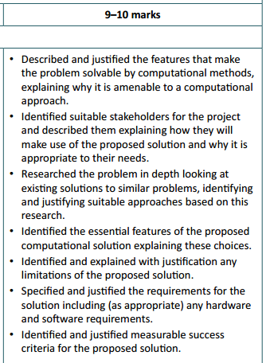
Analysis – brief overview
Candidates will need to discuss why their project will be solvable using computational methods
Clearly identify their stakeholders, and the roles they will play
Show evidence of looking at other systems/ideas
Link this research into their proposed designs
Focus on key features (e.g. GUI Layout, Data structures) and explain whey they have chosen these
Clearly delimit their problem and identify where they feel their project may face issues/limitations, discussing why these exist and the potential impact on the project
Generate an overarching set of requirements for the project and also identify hardware/software requirements where needed:
  This may link to Software Versions (e.g. Only working on certain releases of web browsers due to functionality requirements)
  Hardware requirements – mostly focusing on unique hardware issues where presents. Generic discussion of a minimal set of requirements for a PC is not needed.
Define a clear set of Success Criteria that is a summary of the above and where each one is justified in relation to the Stakeholders/research etc.
© OCR 2016

Slide 15
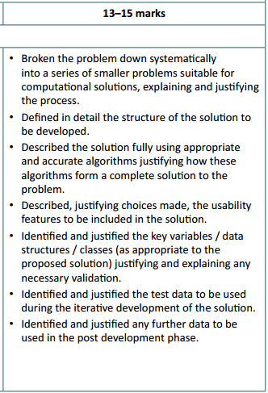
Design – brief overview
Candidates should be using a suitable design methodology for their chosen project + language. For instance, use of class diagrams for OOP, or Top Down Design for Procedural.
Each smaller problem should be justified as to why this is a suitable “chunk” and how it fits in to the grand scheme
Flow Charts, Data Flow, Pseudocode etc should be used appropriately to then design the program
There is no specified design methodology
Psuedocode is inherently required
The emphasis is that a 3rd party should be able to implement the solution directly from the designs
Suitable data structure design should be used as well
Test data for the initial designs should be specified on a ‘module by module’ approach, as well as test data that will be used to ensure all of the Success Criteria are met
Awarding of marks for Design and Test plans may be awarded at a later date if the candidate decides that initial designs/tests may need modification/adaptation
© OCR 2016

Slide 16
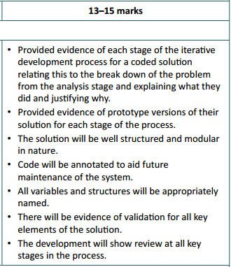
Development – brief overview
Avoid ‘death by screen shot’
Prints of Code blocks/modules with descriptions are fine – no need for ‘line by line account’
Highlight unique features or ‘complex coding’ etc – i.e. Showcase the complexity
Develop in blocks/chunks as defined in the design
Test as you go – no need to wait until the end
Agile/Iterative/RAD styled development
Good annotation in code will reduce quantity of writing
‘Lean and Mean’ – keep the development as concise as possible
Ensure good naming conventions are used (should be included in designs). Candidates that use Form_1 etc, are not showing good maintainability of code.
Highlight the validation – emphaise robust coding
Check Points/Milestones after each module – review back to Success Criteria
Signed of development by Stakeholders for each iteration
© OCR 2016

Slide 17
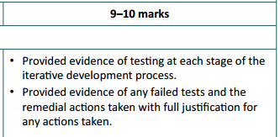
Testing (Development) – A Brief overview
Test at the end of each ‘module’
No need to screenshot every test – especially if repetitious
Highlight failed tests
Must be enough to convince moderator of working solution
It is fine to re-design etc at this point and you can still refer to this redesign to reflect a full working solution when awarding marks in the Design Section
Any modification of test plans may also be used in the same way
Must show re-development and testing where appropriate to gain full marks
Ensure all white box testing (functionality) is completed at this stage.
Testing for Use Acceptance (black box) is contained as part of evaluation
This may form part of the testing they do as they develop, but is awarded in AO3.3, rather than AO3.2
© OCR 2016

Slide 18
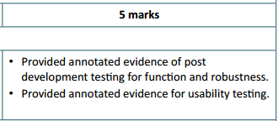
Evaluation (Testing) – A Brief overview
Black Box testing / User Acceptance Testing
Involve all Stakeholders
Identify issues raised from testing
Again, it is fine to discuss solutions to any ‘failures’ and repeat the design/implementation phases to solve issues
Must prove that the system meets all of the success criteria
May reference successes from earlier in project – no need to repeat
Reference clearly back to evidence through page numbers (and make sure they are correct!)
© OCR 2016

Slide 19
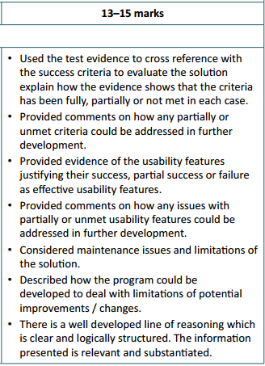
Evaluation – A Brief overview
Summary of final Success Criteria
  Again – cross reference to any earlier evidence to save repetition
Identify any potential limitations arising from the solution
  A) They may go back and edit/customise if time allows
  B) Critique if these are in fact future development problems
Evidence that GUIs and Features are suitable and effective
Discuss development of features that may be functional to meet success criteria, but could also be improved
Explain impact of this development on final product
Discuss how the system will need to be maintained
  Refer to code maintenance
  Evolving requirements of Stakeholders
Refer to evidence, development, research etc. to support all of these justifications clearly.
Ensure that sources are robust and wide-ranging
© OCR 2016

Slide 20
General Guidance
Drive to reduce the volume of paperwork submitted
Link back to evidence where needed – cut out repetition
Focus on coding elements and complexity
Reward design/testing plans where they occur and holistically for the mark band
  (i.e. initial non-working designs that are then corrected will be rewarded)
Removal of user guide – no requirement to have to write one any more
Interaction with Stakeholders is fine – but not cumbersome!
It may be appropriate to provide video evidence of working solution if write-up does not do it justice
© OCR 2016

Slide 21
New Teacher Oriented Moodle MOOC
Will be free to use
Cover all Theory and Programming
Include repository of shared resources
Built in teacher assessment
  When downloaded for use locally
CPD Courses/Videos etc.
  Best Practice
  New CPD Courses now being made available through our CPD Hub
© OCR 2016

Slide 22
How to keep in touch
OCR Website – www.ocr.org.uk
Twitter: @ocr_ict
  tweet/follow for resources/ideas/news/updates etc
We are on CAS
Facebook GCSE Group: https://www.facebook.com/groups/266581410111152/
Customer Contact Centre
  Tel: 01223 553 998
  Email: computerscience@ocr.org.uk
Please talk to us! We love to hear about:
  Ideas for resources
  Good sites for sharing
  Comments on improving our service etc!
  Positive feedback!
© OCR 2016

Slide 23
OCR Resources: the small print
OCR’s resources are provided to support the teaching of OCR specifications, but in no way constitute an endorsed teaching method that is required by the Board, and the decision to use them lies with the individual teacher. Whilst every effort is made to ensure the accuracy of the content, OCR cannot be held responsible for any errors or omissions within these resources.
© OCR 2016 - This resource may be freely copied and distributed, as long as the OCR logo and this message remain intact and OCR is acknowledged as the originator of this work.
OCR acknowledges the use of the following content: n/a
Please get in touch if you want to discuss the accessibility of resources we offer to support delivery of our qualifications: resources.feedback@ocr.org.uk
© OCR 2016

